Slide 1
04- Kafka Connect

Slide 2
What you will learn in this course 🧐🧐
What is great in development is the idea of trying to never reinvent the wheel. This is what Kafka Connect is all about! Pre-written connectors that serve as producers, consumers or both! In this course, we will cover:
Kafka Connect basic vocabulary
How to setup connectors

Slide 3
Kafka Connect Dictionary 📖
Like everything in tech, Kafka Connect has it own little jargon that you need to understand to feel comfortable learning the tool. Fortunately, there not much you need to remember, simply:
Source - Equivalent to a Producer in "normal" Kafka. This is where your data is being produced
Sink - Equivalent to a Consumer in "normal" Kafka. This is where you will dump your data
Task - It's actual code that bring from a Source to a Sink. There can be several tasks inside a broker
Connectors - The link between a Source and a Sink
Connectors can be either a Source or a Sink or both! They are also compatible with your classic producer and consumer. Meaning, you can definitely have a normal python producer and a connector Sink, it will work! 💪

Slide 4
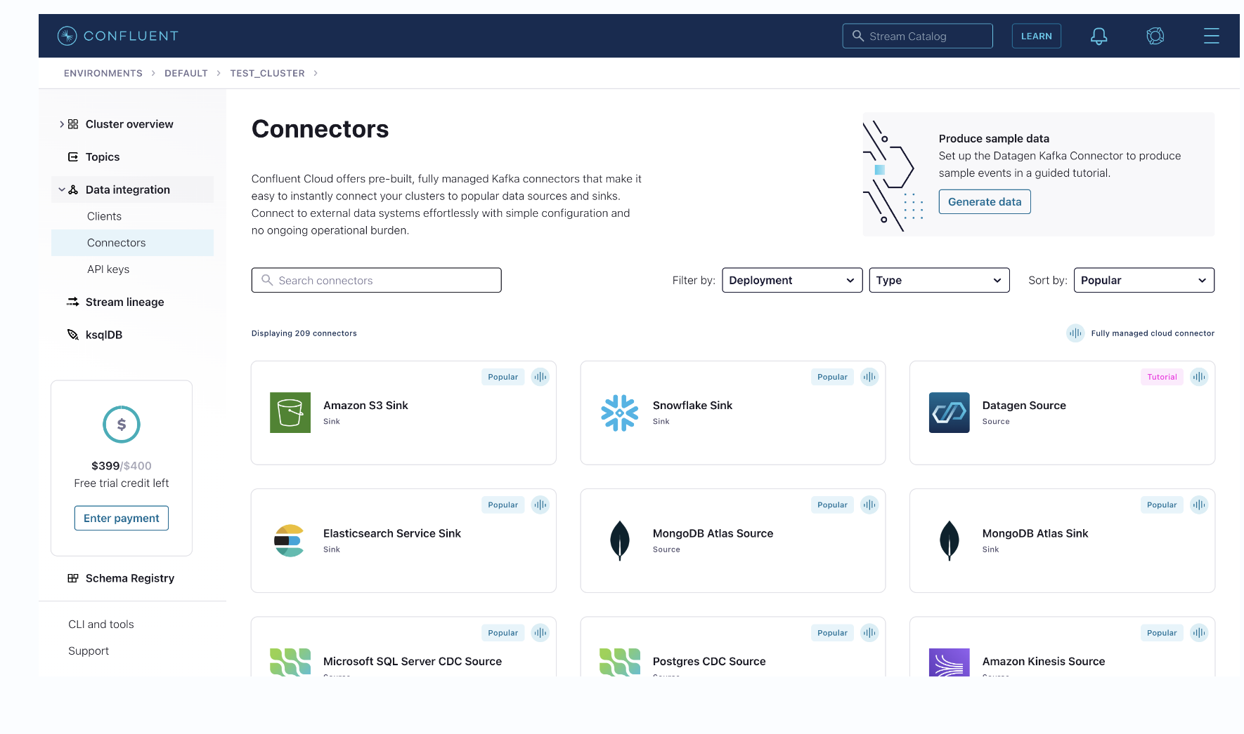
Create your first connector
To create your first connector, it is actually extremely simple. All you have to do is to go back to your Kafka Confluent Cloud account and go to Connectors inside Data Integration section:

Slide 5
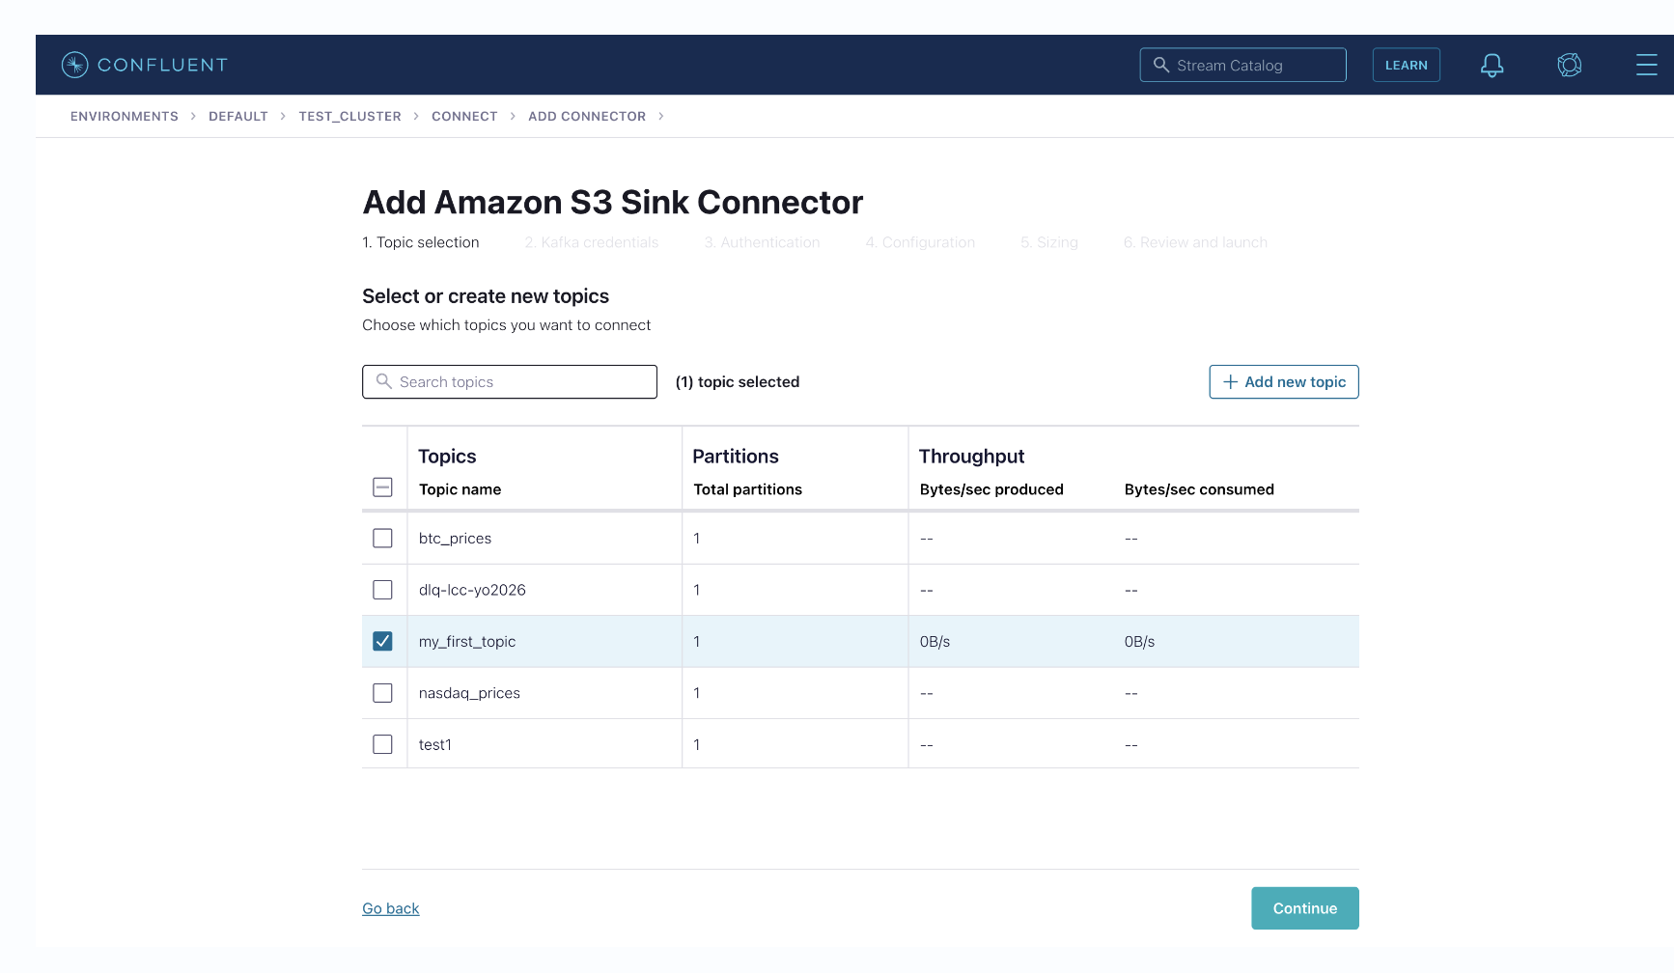
Create your first connector
Now you can choose among a list of pre-configured connectors! Let's choose S3 Sink connector: Choose a Topic you want your connector to subscribe to

Slide 6
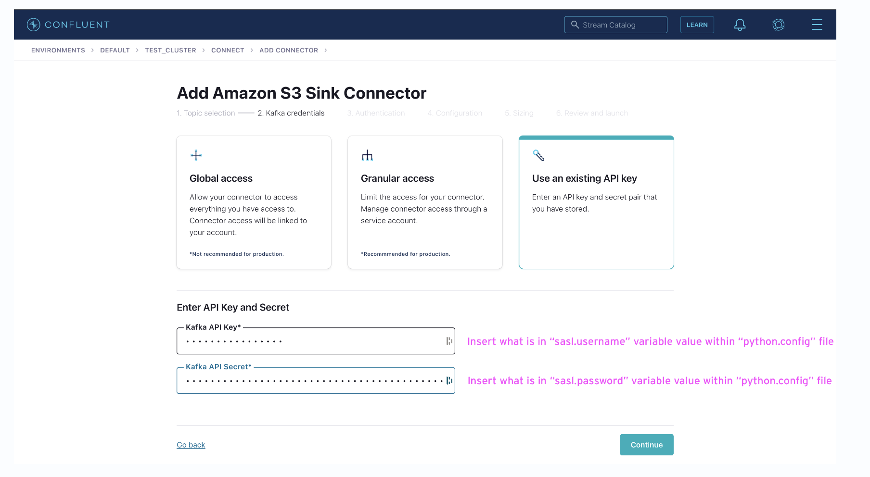
Create your first connector
Create or use an existing API Key to provide to your connector:

Slide 7
Create your first connector Provide your AWS credentials as well as your bucket name:

Slide 8
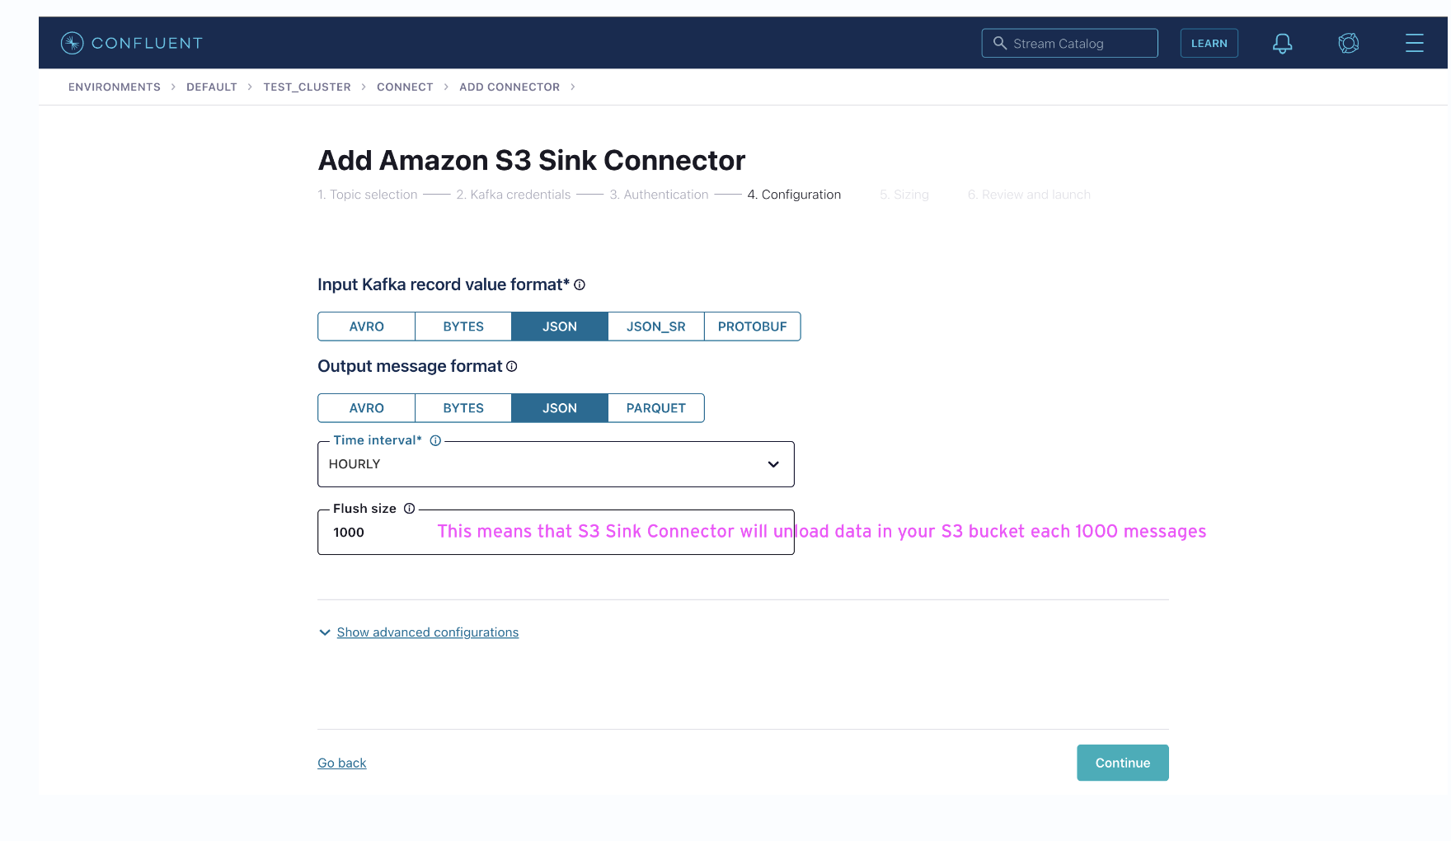
Create your first connector Configure your the way your connector will sink data into your bucket

Slide 9
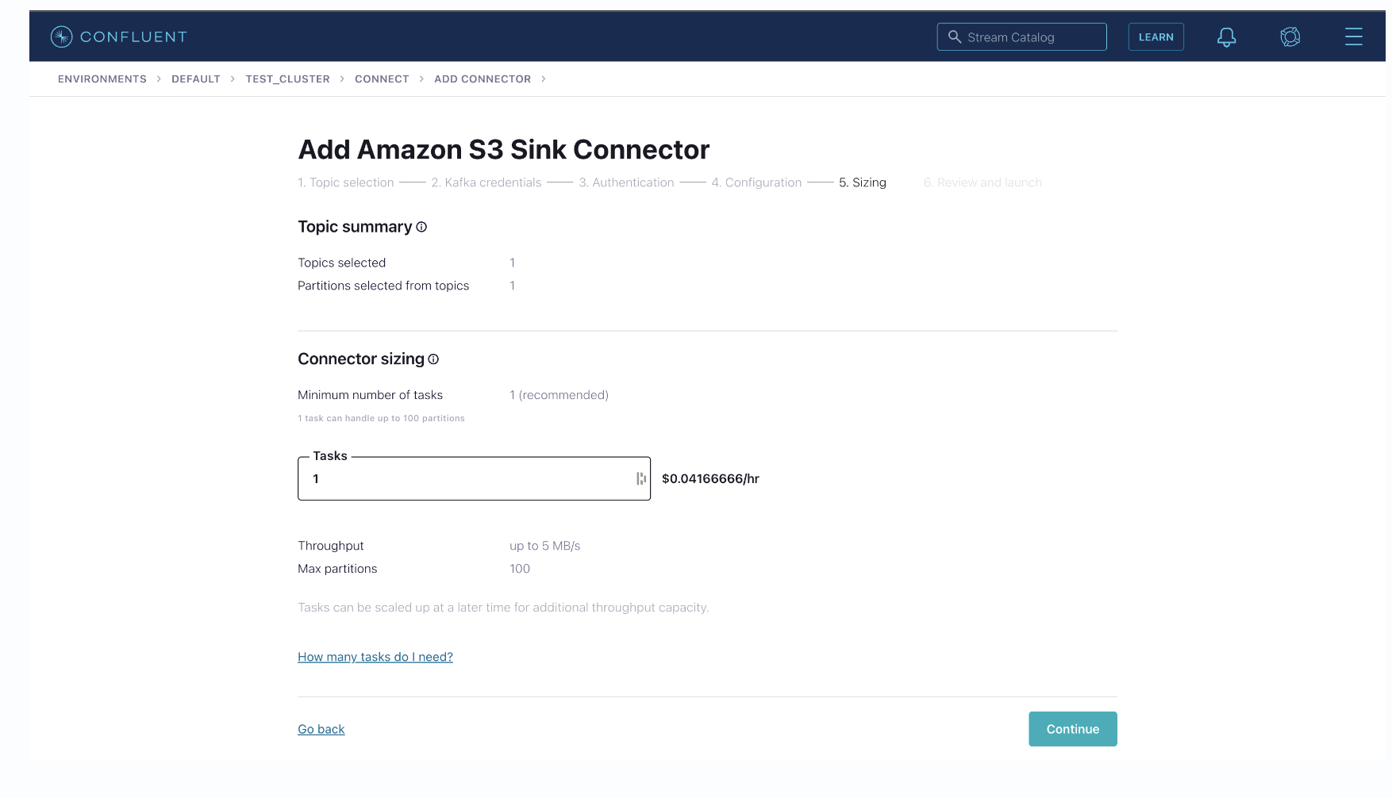
Create your first connector Define how many workers you need for that task

Slide 10
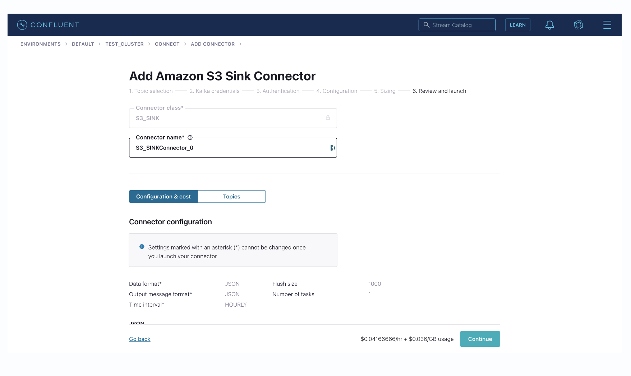
Create your first connector Provide a name to your connector

